Slide 1
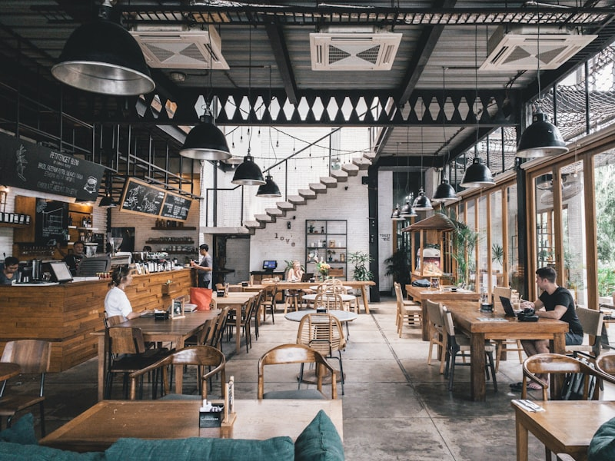
★ BCA 2ND YEAR MINOR PROJECT • LIVE ON CAMPUSMART.ONLINE
Campus Mart
Smart Multi-Vendor Pre-Order & Campus Essentials Ecosystem
• Order food, snacks & stationery from classroom on smartphone
• Multi-shop counter order isolation (23 Outlets & 1,963+ Pure Veg items)
• Live 20-min freshness countdown & Web Audio pickup alerts
• Gate No. 2 Parcel Concierge & New Look Men's Salon integration
• Automated Revenue Split (₹2.50 Platform Profit) & Live Cash Ledger
👤 Presented By: Deepak Sharma | Roll No: TCA2568124
🏛️ Department of Computer Applications (BCA)
⚡ Tech: Python Flask REST API + MongoDB NoSQL + PWA / APK

Slide 2

CURRENT SCENARIO & CHALLENGES
The Problem: Canteen Rush & Break Delays
Why physical counter queuing fails during 15-minute campus lecture intervals
⏱️ 15-Minute Break Bottleneck
During short lecture breaks, hundreds of students rush to food counters simultaneously, creating extreme congestion.
🏃 Late Entries & Missed Lectures
Students wait 20+ minutes at food or stationery counters and arrive late to subsequent academic sessions.
🚶 Distant Gate 2 Parcel Walk
E-commerce parcels (Amazon, Flipkart) stop at Gate No. 2, forcing students to walk 800m back and forth.
📉 Cash Handling & Order Mixups
Handling coins, manual paper slips and delayed food hand-offs causes friction and cold food delivery.

Slide 3
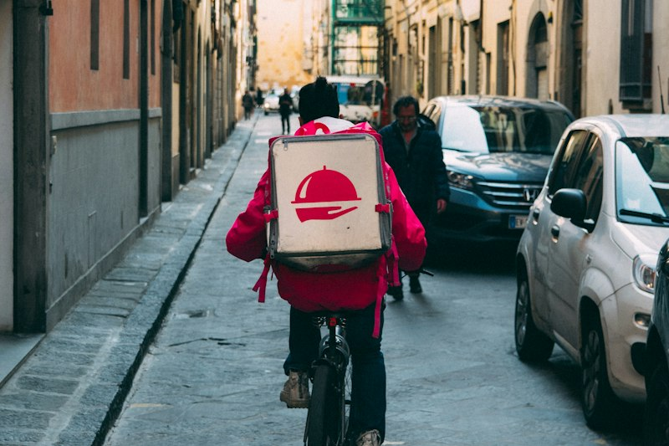
PROJECT OBJECTIVE & INNOVATION
The Solution: Digital Pre-Ordering Ecosystem
Transforming campus food & stationery commerce into an express zero-wait pipeline
📱 Order Directly from Classroom
Browse hot food, packaged snacks, drinks, and stationery on any mobile browser before break starts.
⏰ Precise Pickup Slot Scheduling
Choose immediate preparation or schedule for upcoming break times (e.g. 1:15 PM Lunch Break).
⚡ Zero-Wait Express Pickup
Walk directly to the designated counter, present digital Token ID on smartphone, collect, and go in 10 seconds!
🏪 Multi-Outlet Aggregation
Order from 23 independent campus shops with consolidated cart and instant split ledger accounting.

Slide 4




EXTENSIVE CATALOG SHOWCASE
Campus Scale: 1,963+ Pure Veg Items Across 23 Outlets
100% Pure Vegetarian certified menu covering dining, groceries, photocopying, and stationery
🍔 Canteen Fresh Food (324+ in Rainbow)
TMU Special Chole Kulcha, Sardar Ji Hub, Paneer Dosa, Deluxe Thali, Biryani, Chole Bhature, Burgers & Rolls.
🍫 Chocolates & Packed Snacks
Cadbury Dairy Milk Silk, KitKat, Snickers, Lay's Chips, Kurkure, Oreo, and Maggi Noodles.
🥤 Chilled Beverages & Fresh Juices
Caffelera Cold Coffee with Ice Cream, Red Bull, Mojito, Sting, Amul Lassi, Fresh Mosambi & Mango Juices.
📚 Stationery & Photo Shop Essentials
Classmate Spiral Notebooks, Practical Files, Gel Pens, Highlighters, Printing & Photocopy services.

Slide 5
INTUITIVE USER EXPERIENCE
How Campus Mart Works: In 3 Simple Steps
From classroom pre-order to express zero-queue pickup
1️⃣ Browse & Add to Cart
• Open progressive web app on smartphone
• Filter by 23 campus shops or category (Food, Beverages, Stationery, Snacks)
• 100% Pure Vegetarian campus certified menu
• Add desired items with custom cooking notes (e.g. 'Extra spicy, no onions')
• Real-time price and split preview
2️⃣ Choose Slot & Checkout
• Select immediate prep or scheduled break time slot
• Choose payment: UPI Split Gateway or Cash on Pickup Counter
• Automatic token generation (e.g. #ORD-104)
• Instant dispatch to designated shop's kitchen dashboard
• Auto-deduction commission recorded
3️⃣ Express Pickup & Bell
• Kitchen packs items in advance
• Web Audio 4-tone chime + Voice announcement rings on student screen
• Glowing green pickup token pops up
• Walk to counter, show digital token, grab packed meal in 10 seconds!
• Rate experience with 1-5 stars

Slide 6
REAL-TIME PIPELINE & FRESHNESS
Live 4-Stage Tracking & 20-Min Freshness Timer
Immediate visual, acoustic, and voice status feedback across student and shop screens
📝 1. Placed (Pending)
Order logged in MongoDB; dispatched to specific shop dashboard.
🍳 2. Preparing (Cooking/Packing)
Shop kitchen prepares hot meal or mart staff packs items.
🔔 3. Ready for Pickup (Alert Triggers)
Web Audio 4-tone harmonic chime + 20-min freshness timer active!
✅ 4. Completed (Handed Over)
Order marked finished; 4-digit PIN verified & invoice generated.

Slide 7
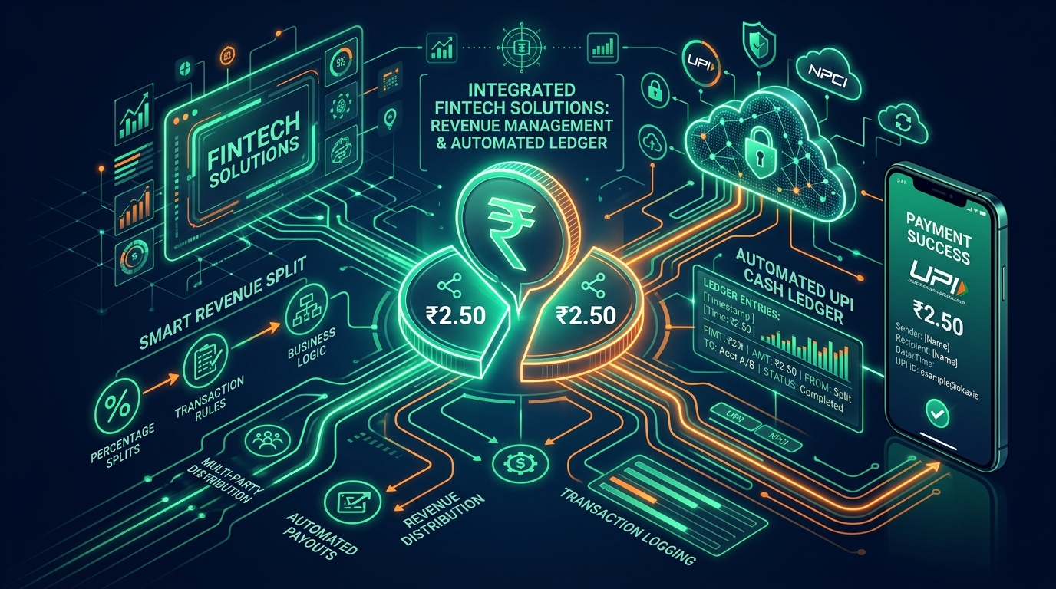
BUSINESS MODEL & MONETIZATION
Fintech Revenue Split Architecture (Platform Profit)
Automated ₹5.00 packaging fee distribution model for sustainable platform revenue
💰 ₹5.00 Pre-Packaging Fee Model
Every pre-order includes a nominal ₹5.00 packaging and convenience charge.
👑 ₹2.50 Platform Profit (Deepak Sharma)
₹2.50 is routed directly to the Platform Founder (Deepak) as pure net service commission.
📦 ₹2.50 Vendor Packaging Cost Share
₹2.50 is credited to the shopkeeper to cover disposable boxes, carry bags, and cutlery.
⚡ Instant Split Routing Simulation
Supports Razorpay Route / Cashfree Split automated transfers directly to linked bank UPI VPAs.

Slide 8
COMMISSION SECURITY & CASH MANAGEMENT
Auto-Deduction Live Cash Ledger System
Solving commission leakage when students pay physical cash at the counter
💵 The Cash Payment Challenge
When students pay cash on pickup, the shopkeeper collects 100% of the money (Food + ₹5.00 Packaging Fee).
Without a ledger, the platform owner risks losing the ₹2.50 commission share on cash transactions.
⚡ The Auto-Deduction Solution
• Automatic debt recording: ₹2.50 recorded under shop's 'Pending Commission Due'
• Automated Offset: Deducted automatically from the shop's next online UPI settlement
• Zero Commission Leakage for Super Admin Deepak!
📊 Live Multi-Shop Balances
Super Admin dashboard provides real-time visibility into all 23 shop ledgers:
• Total Orders & Gross Merchandise Value (GMV)
• Online vs. Cash Orders breakdown
• Net Commission Due per outlet
🤝 1-Click Manual Settlement
Super Admin can click 'Settle Cash Ledger' once shopkeeper clears physical cash balances, instantly generating a timestamped audit record.

Slide 9

ROLE-BASED ACCESS CONTROL (RBAC)
Multi-Shop Counter Isolation & Super Admin Control
Dedicated shop accounts with centralized Super Admin authority
🔒 Counter-Specific Order Isolation
Rainbow Canteen, Chai Nagri, or Photo Shop staff only see orders placed for their specific outlet.
👑 Super Admin Master View (Deepak)
Deepak Sharma has omniscient master view with an instant shop filter switcher and live revenue charts.
🔑 23 Dedicated Shop Admin Logins
Stored securely in Shop_Admin_Credentials/ folder for each shop manager (e.g. rainbow@campusmart.in).
🛡️ Staff Approval Workflow
New counter staff registrations require explicit Super Admin approval before dashboard access.

Slide 10
CUSTOMER FEEDBACK & QUALITY CONTROL
Student Star Ratings & Sentiment Analytics
Maintaining high food quality and hygiene standards across campus outlets
⭐ 1-5 Star Interactive Ratings
Students can rate each completed meal with interactive gold stars directly from their order history.
4.9 / 5.0
★★★★★
Verified Campus Rating Score
Based on 100% Real Student Feedback
[⚡ Fast Pickup] [🍲 Delicious] [✨ Hygienic]
🏷️ 1-Tap Sentiment Tags
Quick impression feedback tags: '⚡ Fast Pickup', '🍲 Delicious Taste', '✨ Hygienic & Fresh', '📦 Good Packaging'.
📊 Admin Quality Analytics
Admin analytics dashboard displays satisfaction trends, total review counts, and 5-star distribution graphs.

Slide 11

ENGINEERING & SYSTEM ARCHITECTURE
Lightweight, Modern Full-Stack Technology
Zero client-side build complexity; ultra-fast response times on campus Wi-Fi / 4G
🌐 Frontend: HTML5 + CSS3 + Vanilla JS
Clean mobile-first glassmorphism UI; instant page load without downloading 100MB+ node_modules.
⚡ Backend: Python Flask REST API
24/7 Render Cloud API serving 1,963+ items, orders pipeline, split engine & RBAC.
🍃 Database: MongoDB NoSQL JSON Store
Flexible JSON document persistence for 26 accounts, 1,963+ pure veg food items & 23 shops.
🔊 Audio Engine: Web Audio API & TTS
Browser-native oscillator chime synthesizer and Text-To-Speech speech synthesis engine.

Slide 12
STRATEGIC VISION & SCALABILITY
🚀 Future Goals & Strategic Project Roadmap
Expanding Campus Mart into an all-in-one smart campus lifestyle super-app
📦 Gate 2 Smart Parcel Locker Hub
• Courier packages (Amazon, Flipkart, Bluedart) delivered to Gate No. 2
• Campus Runner Fleet brings parcels straight to hostel room doors
• 4-Digit Secret Delivery PIN verification protects every package
• Automated courier SMS & tracking sync
• Eliminates 800m daily walking friction for hostellers
💈 Men's Salon & Campus Super-App
• New Look Men's Salon Virtual Queue & zero-wait barber chair reservation
• Real-time waiting time estimation before leaving hostel room
• 1-Click Group Bill Split with custom share calculation
• Direct QR Code scanner for 2-second meal handover
• Multi-Campus University Expansion across North India

Slide 13
MEASURABLE IMPACT & PROJECT ACHIEVEMENTS
Current Campus Impact & Measured Value
Quantifiable time savings for students and revenue clarity for platform & shop owners
🌟 Key Campus Achievements
• Saves 15-20 minutes during every lecture break
• 100% elimination of physical queue bottlenecks
• Zero missed classes or late lecture entries
• 100% Pure Vegetarian certified dining across 23 Outlets
• Automated ₹2.50 revenue split with zero cash leakage
• Web Audio chimes & synthesized voice pickup alerts
👑 Business Model Highlights
• ₹2.50 Platform Profit per pre-order directly to Deepak Sharma
• ₹2.50 Shopkeeper Packaging Material Share
• Auto-Deduction Live Cash Ledger protects all cash orders
• Role-Based Access Control for all 23 campus food/stationery shops
• High customer satisfaction score (4.9 / 5.0 ⭐)

Slide 14
★ PROJECT SUMMARY & CONCLUSION
Thank You!
Campus Mart successfully bridges the gap between campus students and food outlets,
delivering a lightning-fast, queue-free, and digitally automated pre-ordering ecosystem.
👤 Presented By: Deepak Sharma | Roll No: TCA2568124
🏛️ Department of Computer Applications (BCA)
🌐 Live Platform: https://campusmart.online
💬 Ready for Live Demonstration, Source Code Walkthrough & Viva Q&A

